Slide 1
Digital Portfolio
STUDENT NAME: s.sanjiv
REGISTER NO AND NMID: 24134031802522042
DEPARTMENT: Bsc computer science ll-year
COLLEGE: COLLEGE/ UNIVERSITY : pspt mgr govt art and science college

Slide 2
PROJECT TITLE
Data science project:a collection of data analysis work

Slide 3


AGENDA
Problem Statement
Project Overview
End Users
Tools and Technologies
Portfolio design and Layout
Features and Functionality
Results and Screenshots
Conclusion
Github Link
3/21/2024 Annual Review

Slide 4

PROBLEM STATEMENT
“Retail companies need to understand product sales trends over time to optimize inventory and forecast demand. This project analyzes historical sales data to uncover trends, seasonal effects, and top-performing products.”
“Retail companies need to understand product sales trends over time to optimize inventory and forecast demand. This project analyzes historical sales data to uncover trends, seasonal effects, and top-performing products.”

Slide 5

PROJECT OVERVIEW
This project analyzes 3 years of sales data from a fictional retail store. Using Python and data visualization tools, it uncovers trends, identifies best-selling products, and provides actionable insights for business decisions.

Slide 6

WHO ARE THE END USERS?
Primary Users: Business analysts and sales managers
Secondary Users: Inventory planners and product teams

Slide 7

TOOLS AND TECHNIQUES
Languages: Python, SQL
Libraries: pandas, numpy, matplotlib, seaborn, scikit-learn
Tools: Jupyter Notebook, VS Code, Git, Tableau (or Streamlit)
Platform: GitHub, Kaggle

Slide 8
POTFOLIO DESIGN AND LAYOUT
Each project is organized into its own folder with:
A README.md for documentation
A Jupyter notebook (.ipynb) with the analysis
A data/ folder (with raw/processed data or links)
Images for screenshots/visuals
Optional: Dashboard app or exported HTML report
8

Slide 9
FEATURES AND FUNCTIONALITY
Time series visualization of monthly sales
Product performance ranking
Interactive filters for category/region (if dashboard)
Customer segmentation using K-means clustering
Forecasting with ARIMA (optional)

Slide 10

RESULTS AND SCREENSHOTS
Product X was the top seller for 8 consecutive months.
Sales dip in February and peak in November.
Region Y has consistently underperformed.
3/21/2024 Annual Review
10

Slide 11
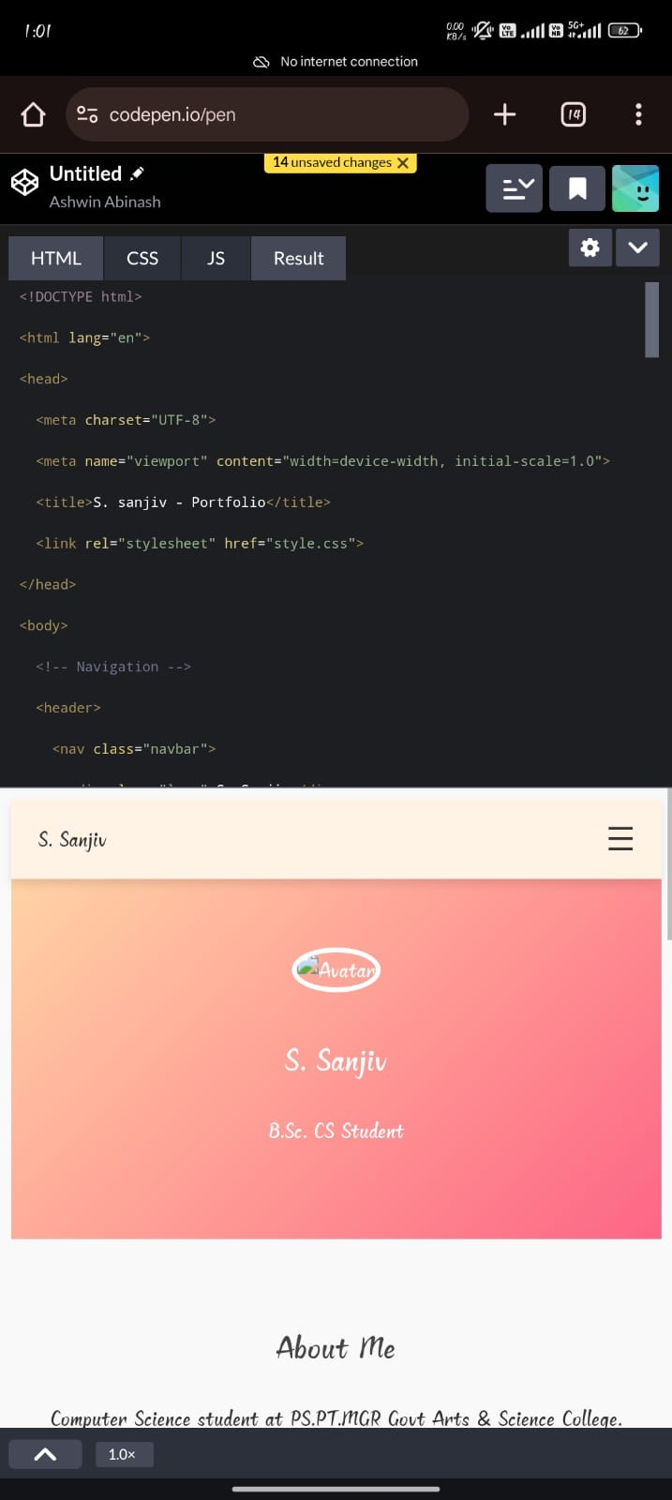
Screenshots

Slide 12
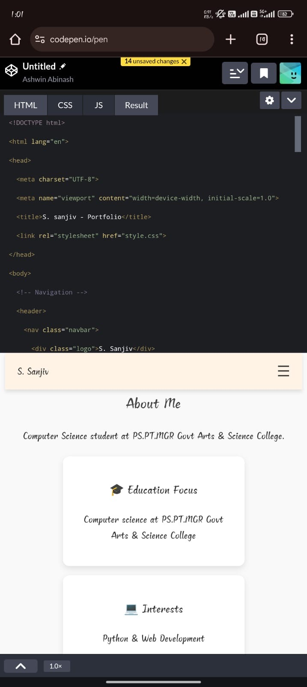

Slide 13
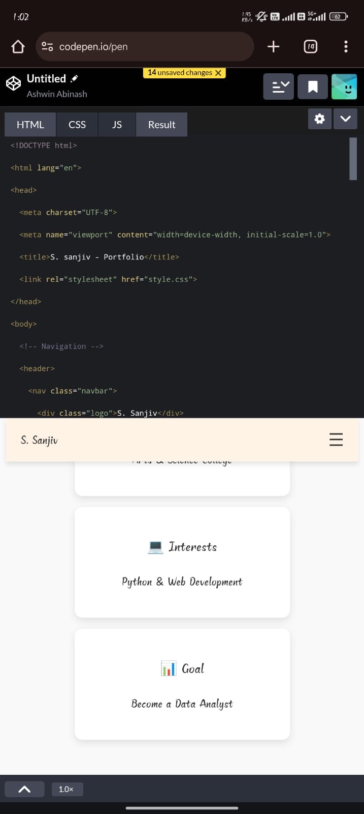

Slide 14
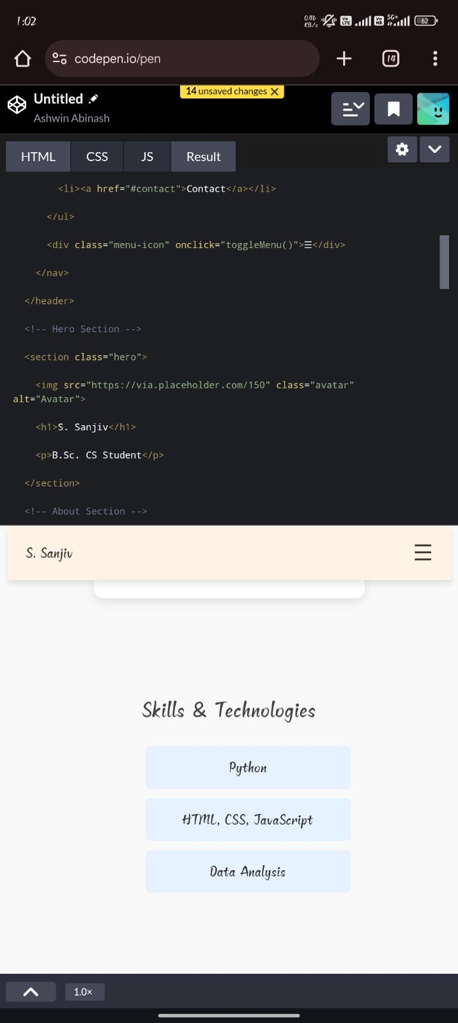

Slide 15
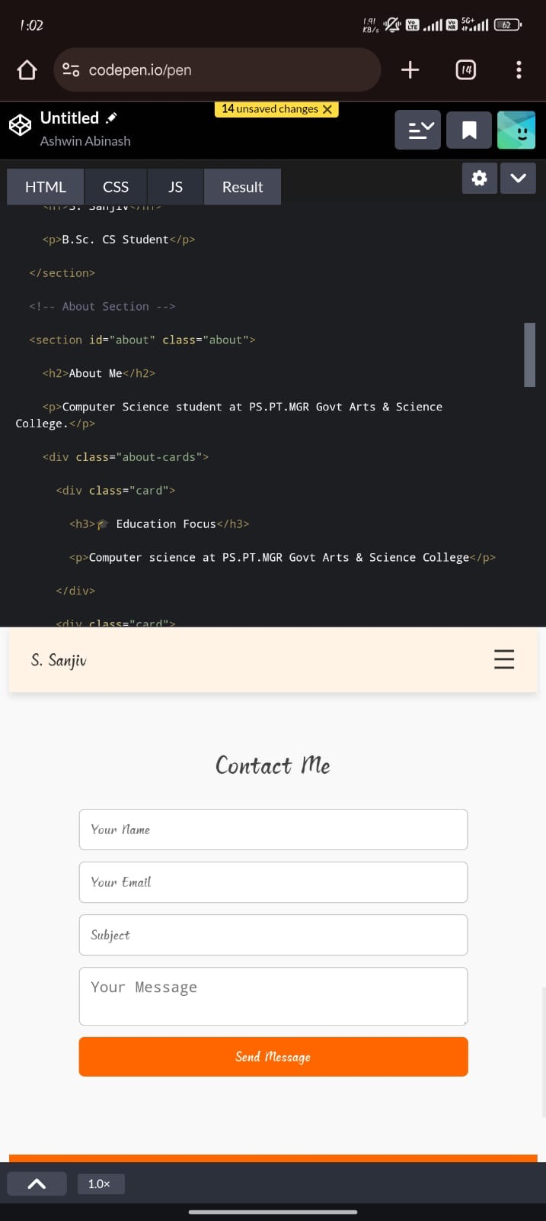

Slide 16
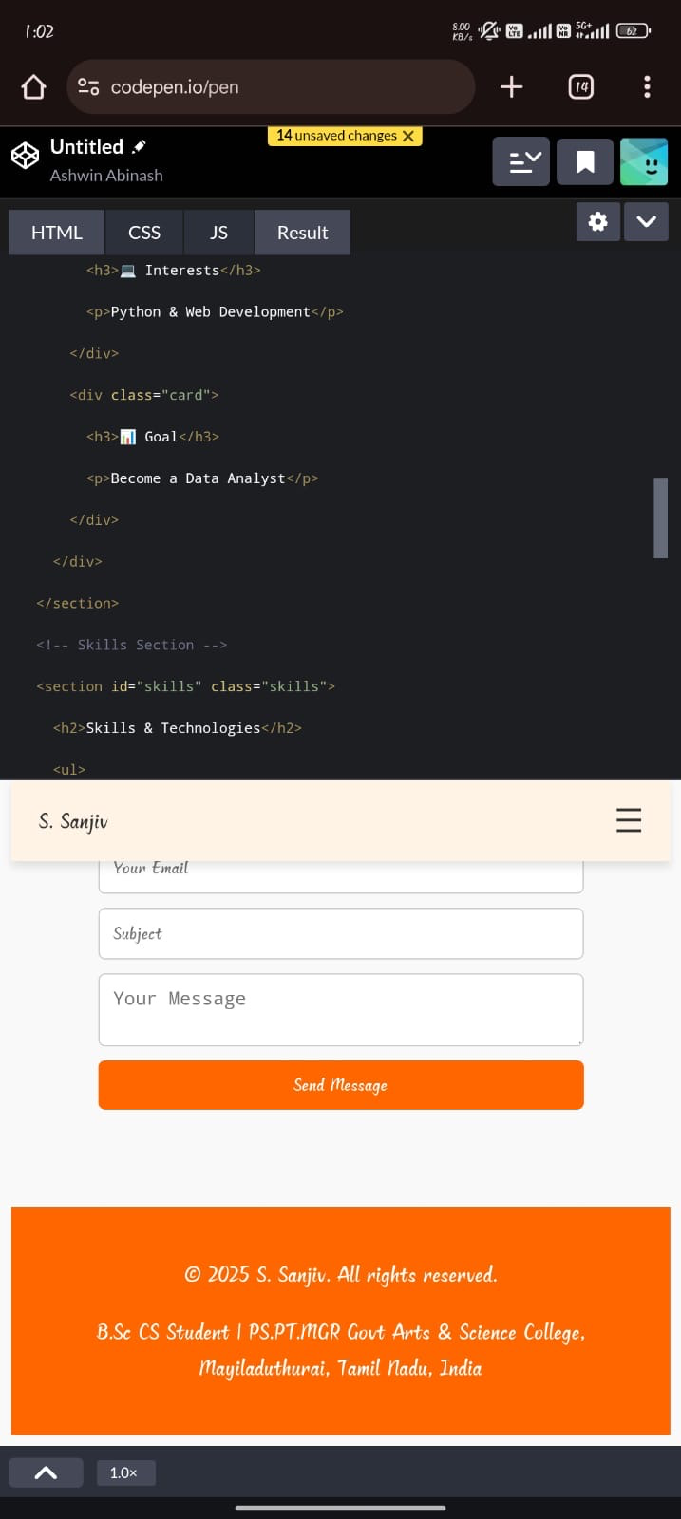

Slide 17
CONCLUSION
This project provided actionable insights into sales trends, helping businesses optimize product strategies and inventory. Future work can include forecasting demand and integrating marketing campaign data for deeper analysis.
17

